Slide 1
Relocating with foursquare
A project to complete the applied data science capstone
Gary Netherton – July 2020

Slide 2
Relocating with foursquare
BACKGROUND: I am relocating for a new job. I have offers in two cities and I want to choose the place where I will stay as I am nearing retirement. I am looking for somewhere primarily with a lot of varied dining and, secondarily, some museums and venues for concerts
Relocating for a new job can be stressful enough
Finding out, after the move, that the area is less-than-desirable can prove traumatic
Age and proximity to retirement make relocation decisions even more critical
Using tools (above and beyond advised visits to prospective areas) such as Python and the Foursquare API, can assist the decision-making process

Slide 3
Relocating with foursquare
DATA ACQUISITION & WRANGLING
Downloaded zip code information, including latitude and longitude from http://www.uszipcodelist.com/download.html
This was a comprehensive list that required further subsetting
Subset the data in Pandas dataframes for Temecula, CA and Portland, OR based on area codes
Data included the main cities in question as well as the surrounding areas
Used the Foursquare API to download venues associated with the cities in the subset dataframes
Generated initial maps using Folium to get a general gist of the areas

Slide 4
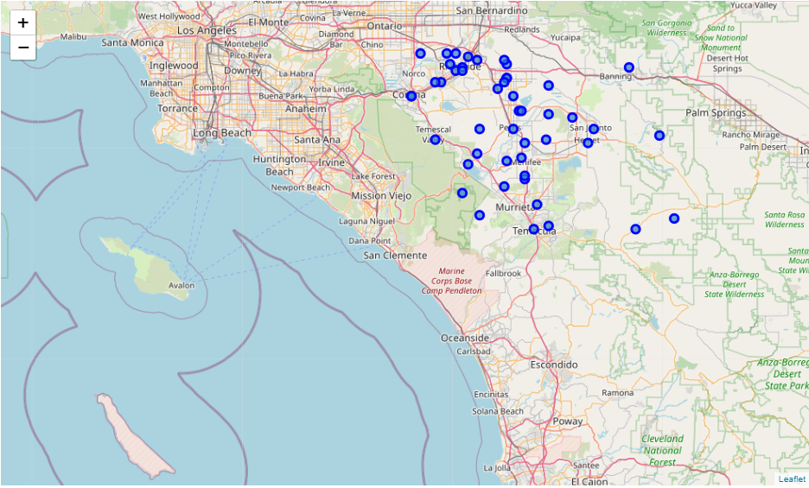
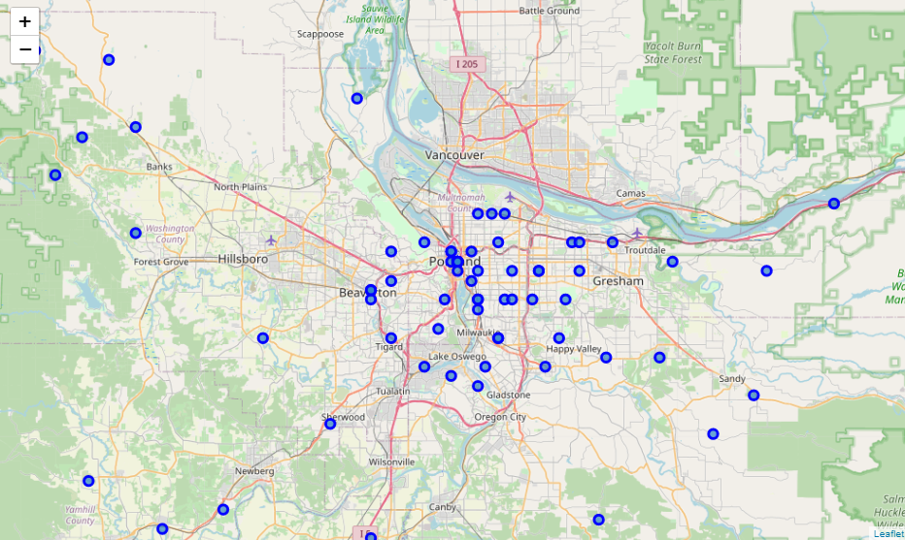
Relocating with foursquare
Data acquisition & wrangling
Temecula, CA
Portland, or

Slide 5
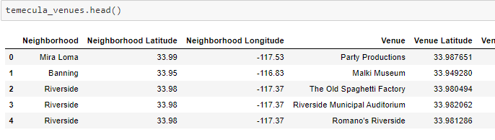
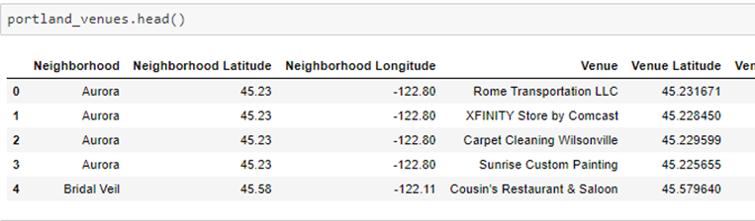
Relocating with foursquare
Data acquisition & wrangling
Portland, or
Temecula, CA

Slide 6
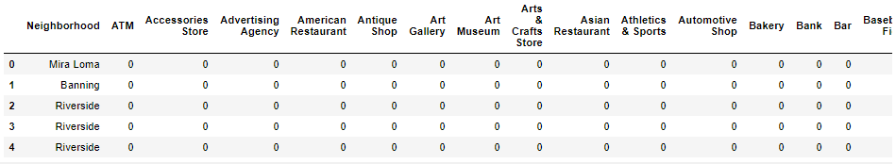
Relocating with foursquare
DATA ACQUISITION & WRANGLING
Analyzing venues and their categories in and around specific cities

Slide 7
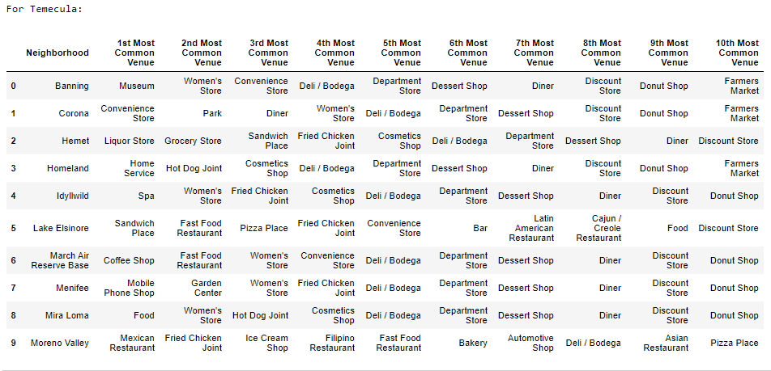
Relocating with foursquare
DATA ACQUISITION & WRANGLING
Prioritizing venues based on frequency within the city

Slide 8
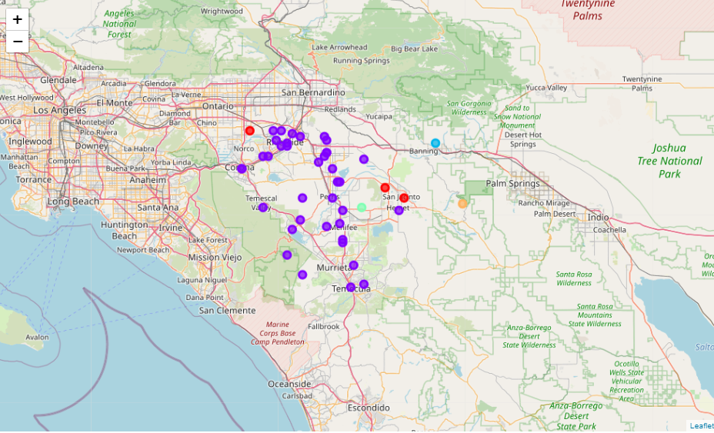
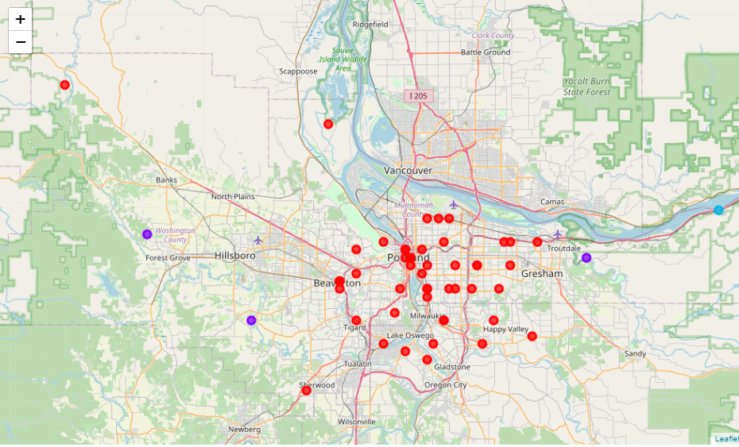
Relocating with foursquare
Evaluating the data (venue identification on map)
Temecula, CA
Portland, or

Slide 9
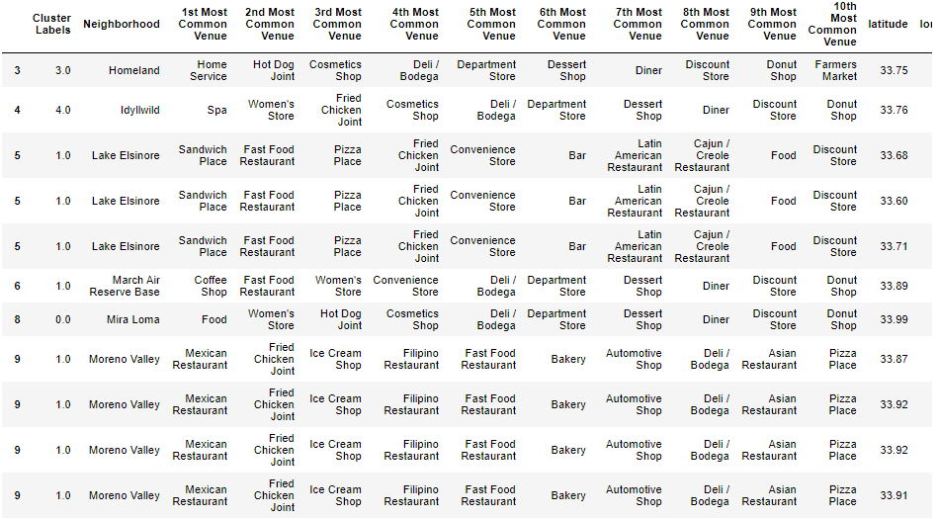
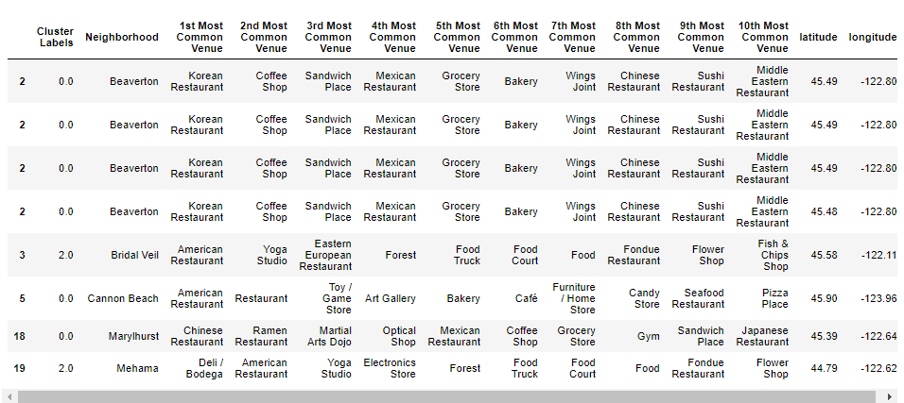
Relocating with foursquare
Evaluating the data (venue identification TABle for food)
Temecula, CA
Portland, or

Slide 10
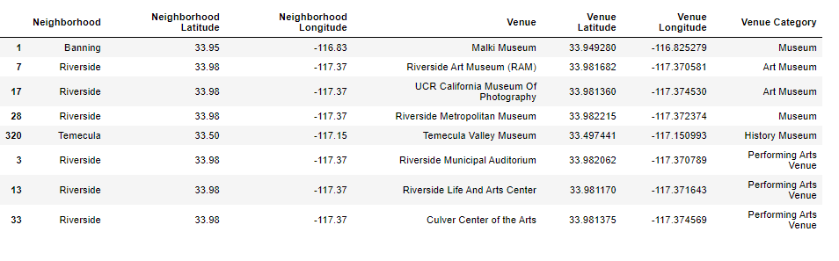
Relocating with foursquare
Evaluating the data (venue identification TABle for culture)
Note: Temecula won the toss for food, so we only evaluated them in culture

Slide 11
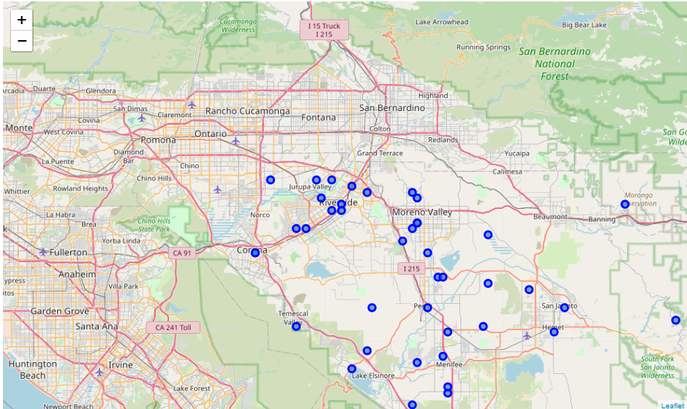
Relocating with foursquare
Final decision: riverside, ca (just outside of Temecula, ca)

